Slide 1
“Word Differences”

Slide 2
Source:

Slide 3
Round 1
Image -> Words

Slide 4
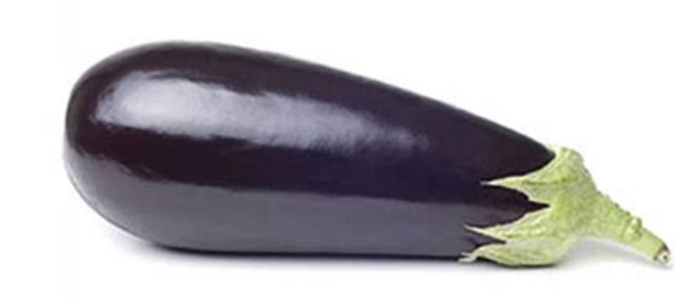
AMERICAN
Eggplant
BRITISH
Aubergine

Slide 5
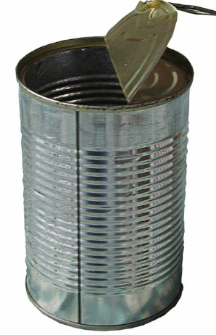
AMERICAN
Can
BRITISH
Tin

Slide 6
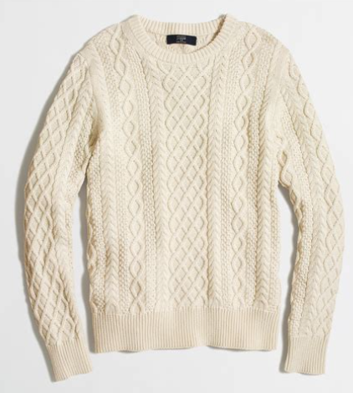
AMERICAN
Sweater
BRITISH
Jumper

Slide 7
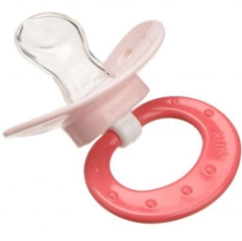

AMERICAN
Binkie
BRITISH
Pacifier

Slide 8
Round 2
Words -> Image

Slide 9
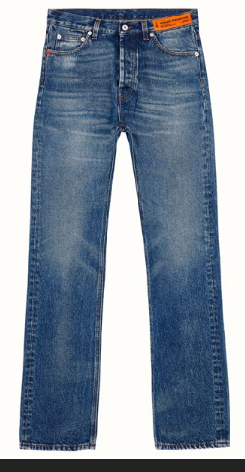
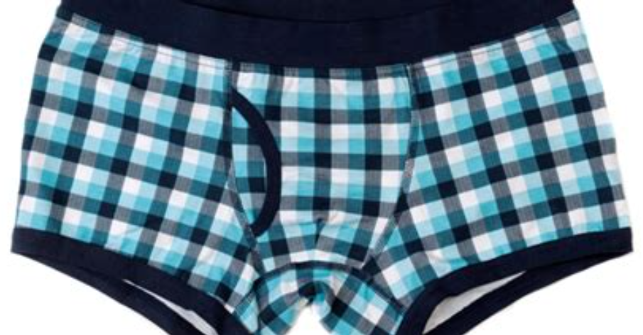
PANTS
AMERICAN
BRITISH

Slide 10
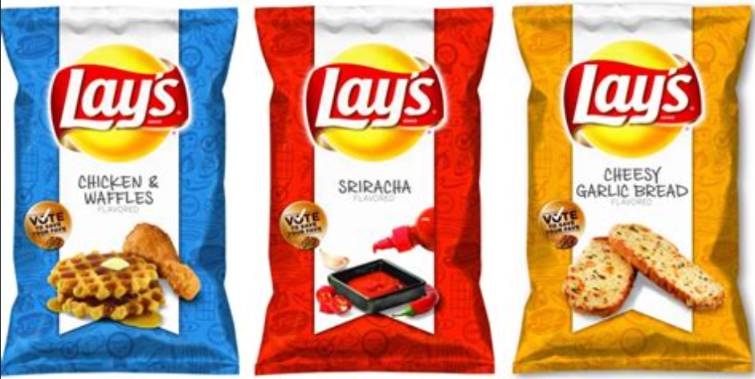
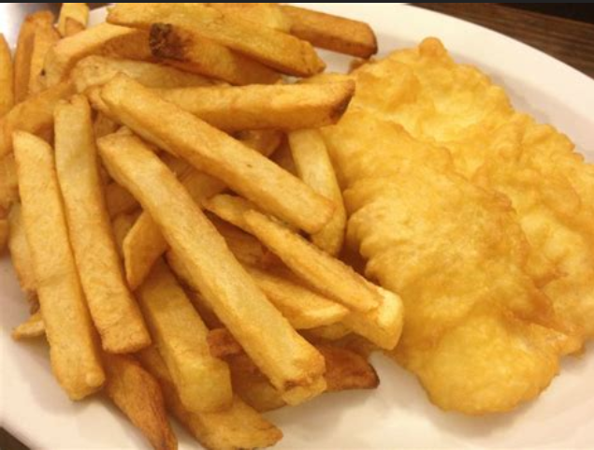
CHIPS
AMERICAN
BRITISH

Slide 11
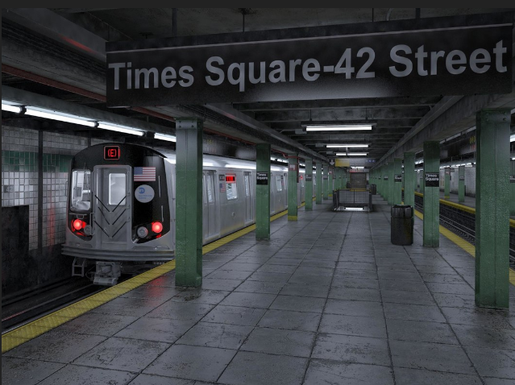
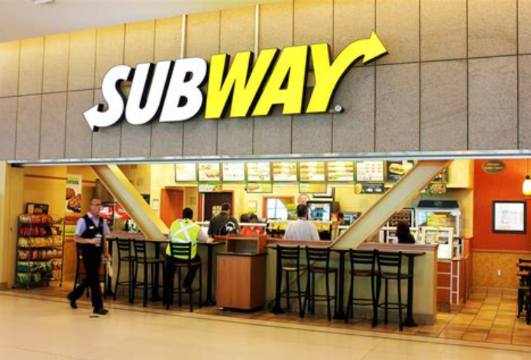
SUBWAY
AMERICAN
BRITISH

Slide 12


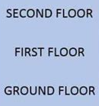
FIRST FLOOR
AMERICAN
BRITISH

